Slide 1
Recap Arm Cortex, Processors & Events
Pirmin Herger & Raphael Kissling
27.3.2017

Slide 2
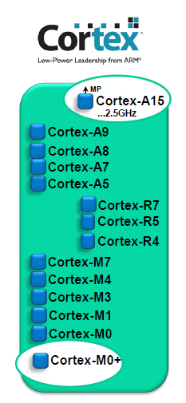
Cortex-M Processor Family
ARM Cortex-A: Applications processors (e.g. used in smartphones)
ARM Cortex-R: Embedded processors for real-time signal processing
ARM Cortex-M: MC-oriented, processors for MCU and SoC applications
Cortex-M7, -M4(F), -M3 (ARMv7-M)
Cortex-M0+, -M0, M1 (ARMv6-M)
Notes:
Further information:
1. 32bit Reduced Instruction Set Computer (reduced command set), constant command length of 32bit
2. Processors used for: M4 (Remote), M4F (Robot), M0+ (Freedom-Board)
3.0 ARM Inc. licenses the configurable core → they don’t produce microcontrollers
3.1 Vendors: (STM,NXP,Texas Instruments,…) implement the device/peripherals

Slide 3
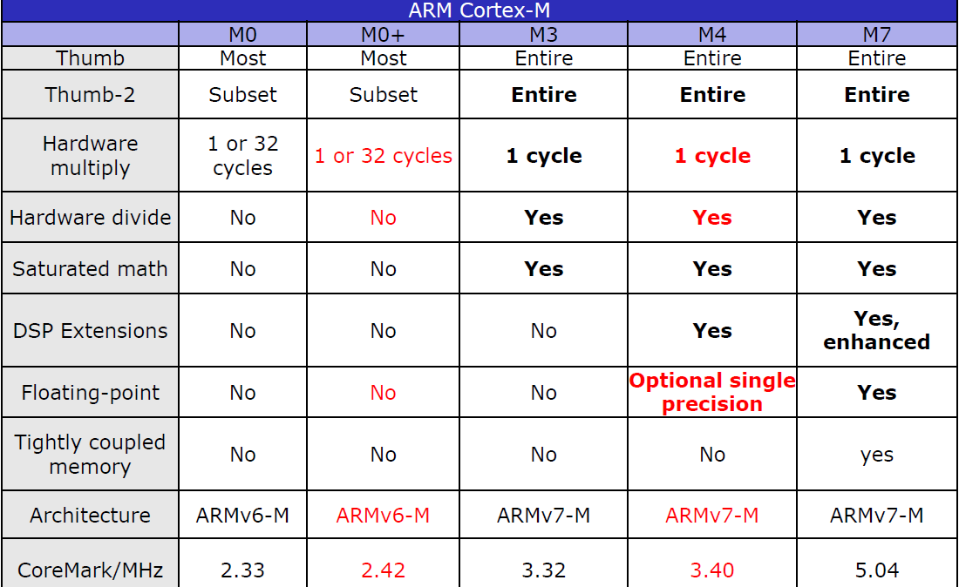
Cortex-M Comparison
Upward compatibility
Hardware multiply
1 or 32 cycles
Hardwre divide
Floating-point
Price:
M0: 40cents
M3-7: 3-4dollar
Notes:
Further Information:
Upward compatibility: you can download M0 with a Cortex-M4 board
Differences M0+ and M4/M4F
32bit hardware multiply: can be synthesized with one cycle -> resulting in a larger chip area (recommended because its faster), or with 32 cycles and less chip area
Hardware divide (shared hardware): M0+ in software
30% of the silicon ist for the floating point (also 30% of the price)

Slide 4
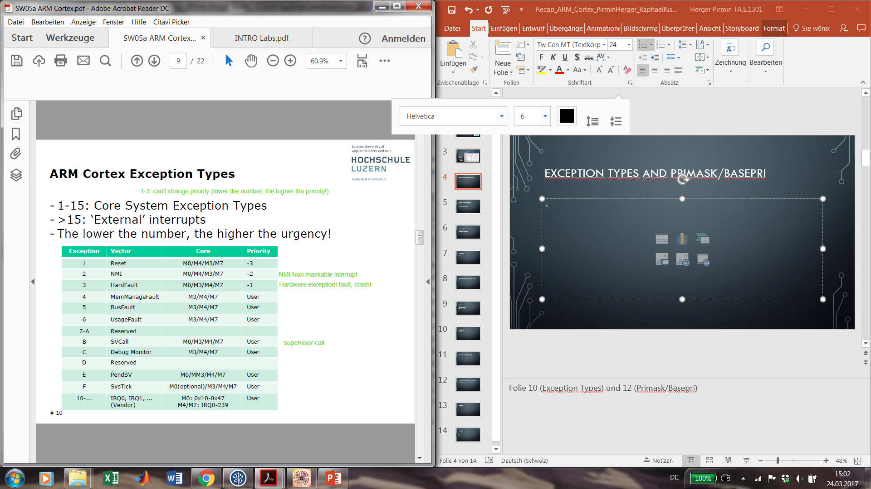
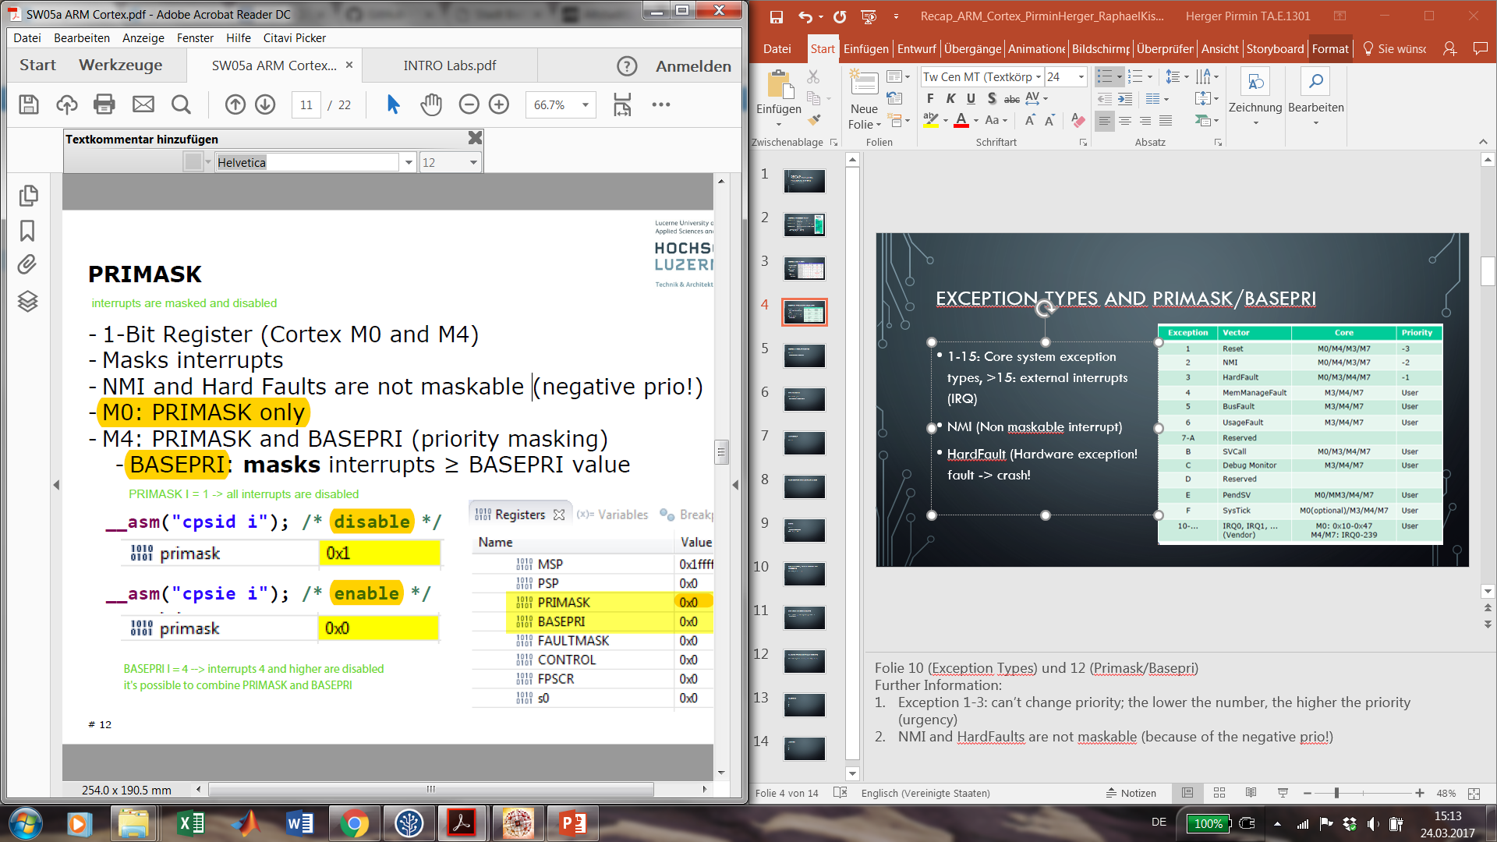
Exception Types and Primask/BasePRI
1-15: Core system exception types, >15: external interrupts (IRQ)
NMI (Non maskable interrupt)
HardFault (Hardware exception! fault -> crash!
M0: (PRIMASK only)
M4: (PRIMASK & BASEPRI)
Notes:
Folie 10 (Exception Types) und 12 (Primask/Basepri)
Further Information:
Exception 1-3: can’t change priority; the lower the number, the higher the priority (urgency)
NMI and HardFaults are not maskable (because of the negative prio!)
PRIMASK I = 1 -> all interrupts are disabled
BASEPRI I = 4 -> interrupts 4 and higher are disabled, it’s possible to combine PRIMASK and BASEPRI. (M4)

Slide 5
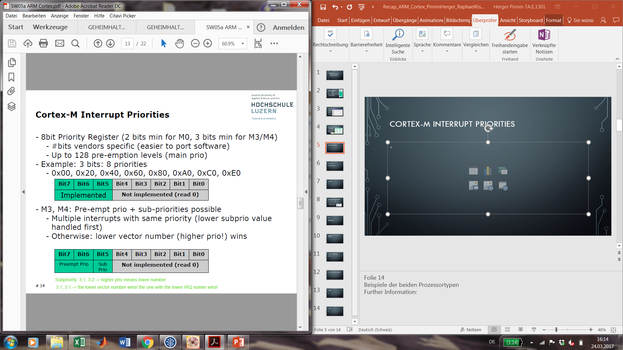
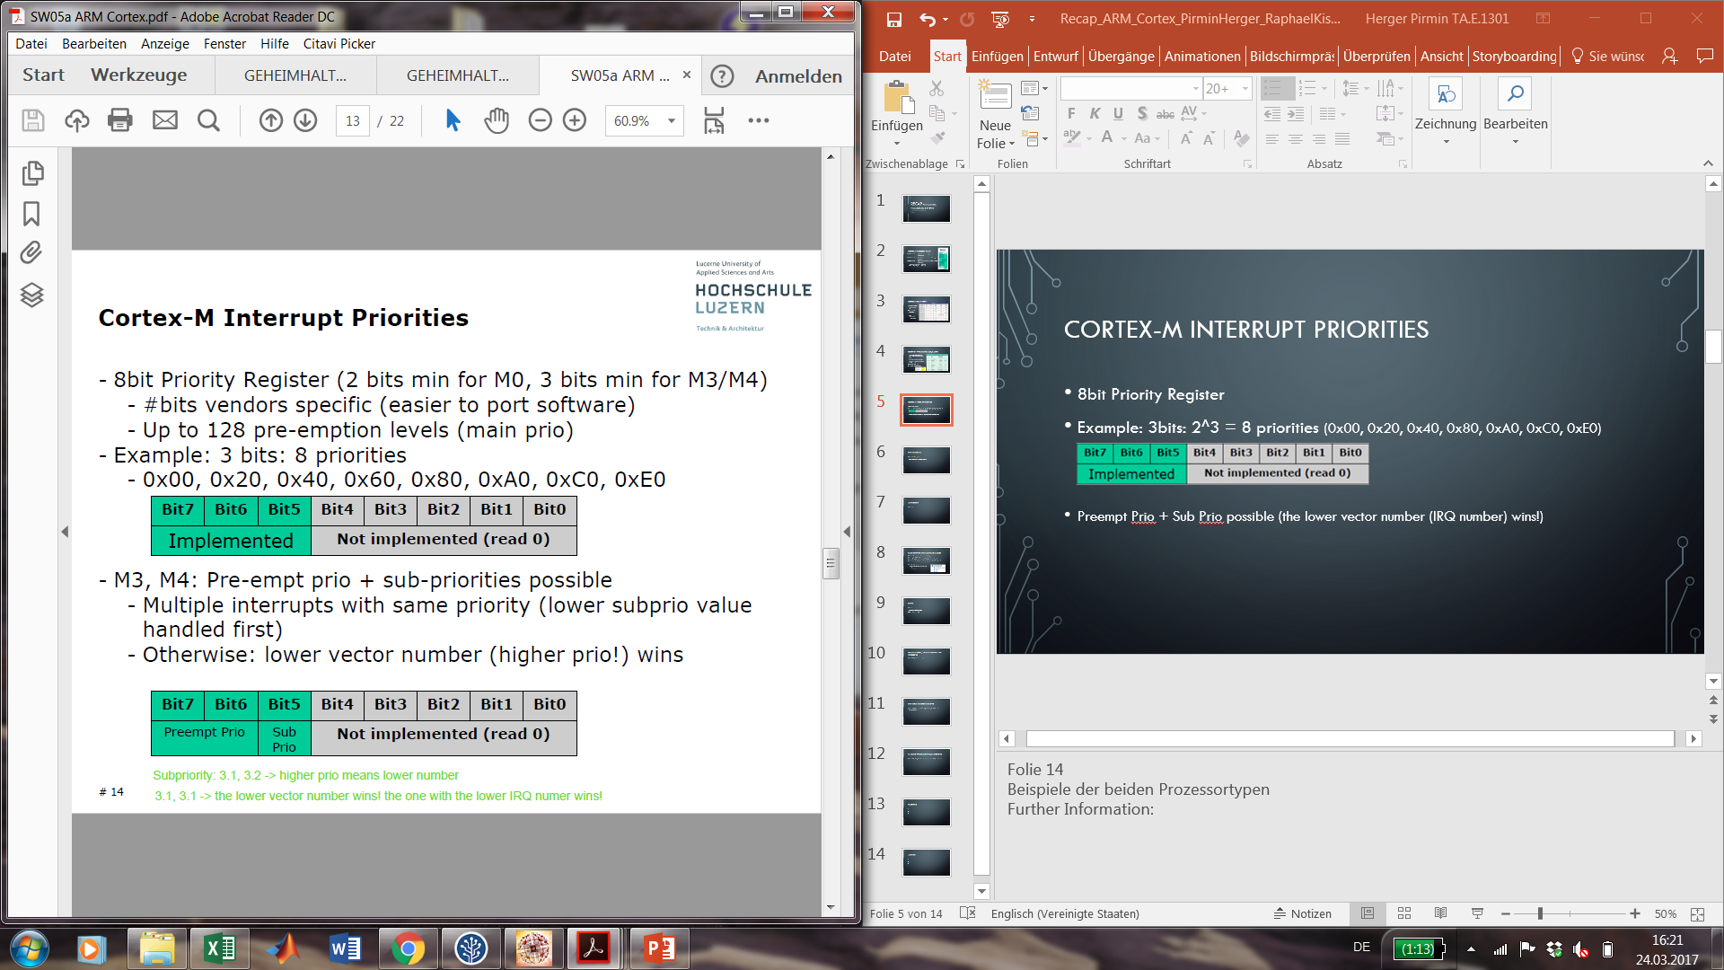
Cortex-M Interrupt Priorities
8bit Priority Register
Example: 3bits: 2^3 = 8 priorities (0x00, 0x20, 0x40, 0x80, 0xA0, 0xC0, 0xE0)
Preempt Prio + Sub Prio possible (the lower vector number (IRQ number) wins!)
Notes:
Further Information:
Subpriority: 3.1, 3.2 -> higher prio means lower number
3.1, 3.1 -> the lower vector number wins! the one with the lower IRQ numer wins!

Slide 6
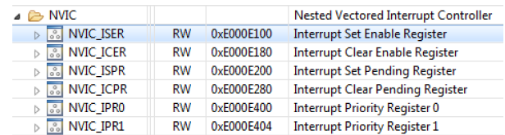
NVIC M0 and M4
Cortex-M0
2bits, 4 Prios
32 user interrupts
1bit each (1 32bit register)
NVIC_ISER, _ICER, _ISPR, _ICPR
8bits each (8 32bit register)
NVIC_IPRx
Cortex-M4
4bits 16 Prios
82 user interrupts
1bit each (4 32bit register)
NVIC_ISER, _ICER, _ISPR, _ICPR, NVIC_IABR
8bits (106 32bit register)
NVIC_IPRx
Notes:
Further Information:
NVIC: Cortex-M0
32 user interrupts (0x10-0x47)
1 bit each (1 32bit register)
NVIC_ISER (Interrupt Set Enable Register)
NVIC_ICER (Interrupt Clear Enable Register)
NVIC_ISPR (Interrupt Set Pending Register)
NVIC_ICPR (Interrupt Clear Pending Register)
8 bits each (8 32bit register) NVIC_IPRx (Interrupt Priority Registers)
NVIC: Cortex-M4
82 user interrupts (0x10-0x61)
1 bit each (4 32bit register) NVIC_ISER (Interrupt Set Enable Register)
NVIC_ICER (Interrupt Clear Enable Register)
NVIC_ISPR (Interrupt Set Pending Register)
NVIC_ICPR (Interrupt Clear Pending Register)
NVIC_IABR (Interrupt Active Bit Register)
- 8 bits each (106 32bit register) NVIC_IPRx (Interrupt Priority Registers)

Slide 7
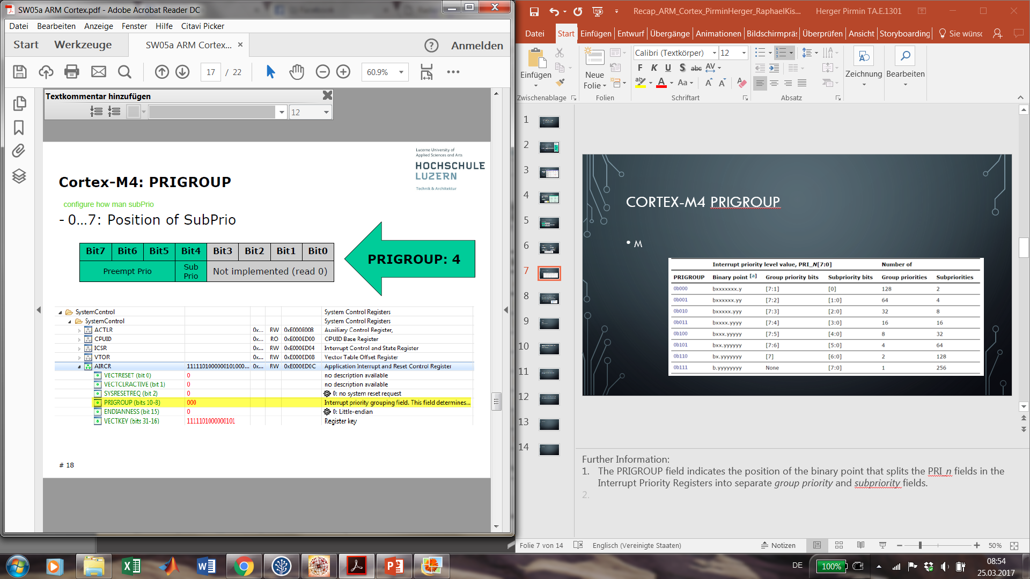
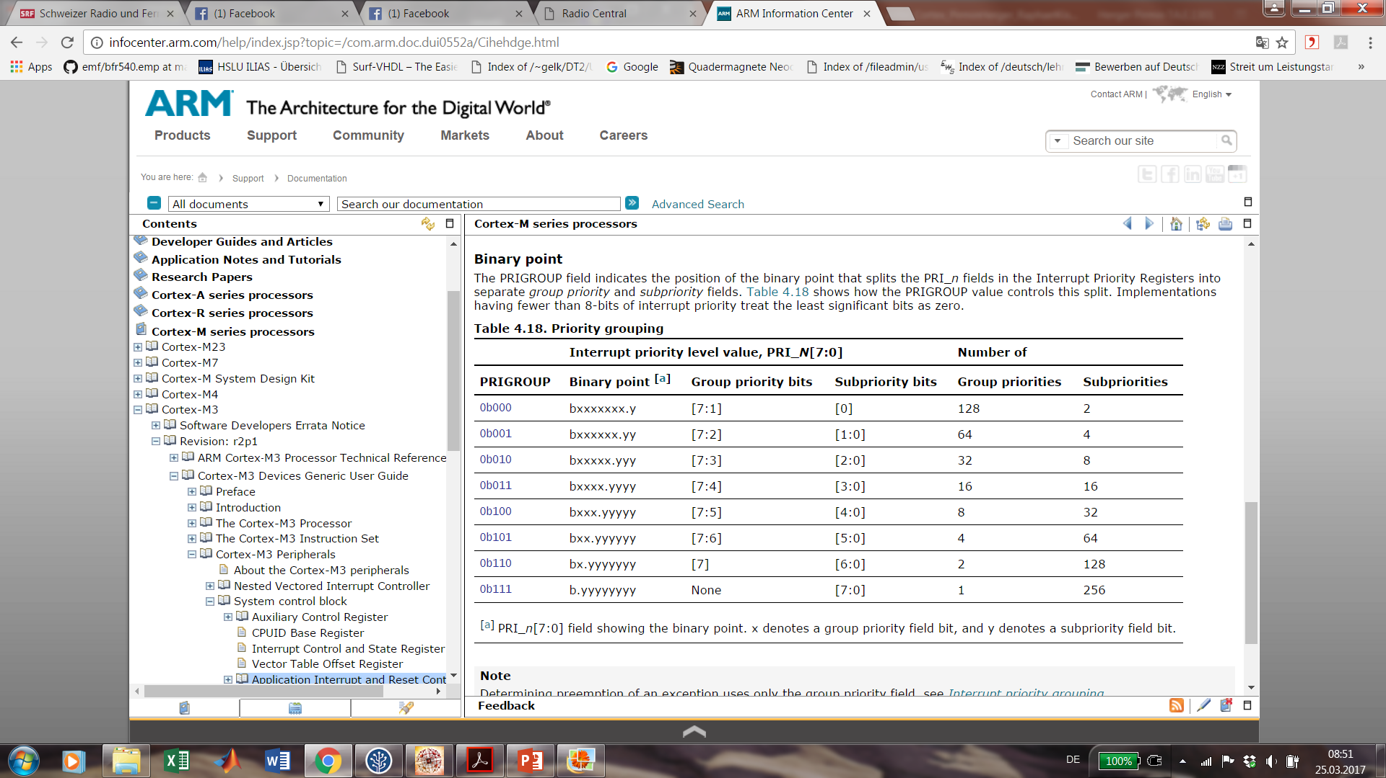
Cortex-M4 Prigroup
0…7: Position of SubPrio
Notes:
Further Information:
The PRIGROUP field indicates the position of the binary point that splits the PRI_n fields in the Interrupt Priority Registers into separate group priority and subpriority fields.

Slide 8
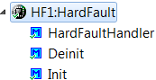
Fault Exception and Hard Fault Handler
Bus Fault – Instruction or data error, stacking error
Memory Fault – Write to read-only, outside of memory map
Usage Fault – illegal instruction, invalid ISR return, unaligned memory access
Conclusion: Hard Faults can be called by above faults conditions!
Hard Fault Handler
Interrupt handler (or debugger) to read:
Link register
PC register
Notes:
Further Information:
Interrupt handler (or debugger) to read special registers and location to find out location of problem.
Hard Fault stack frame different from normal ISR frame

Slide 9
Events
Folie 4
Synchronous vs Asynchronous
Different Implementations

Slide 10
Execution Speed / Decoupling Event and Processing
Folie 7 & 8 (fast and slow part)

Slide 11
EVNT Array and Storing Events
Folien 9 (EVNT Array) und Folie 10/11 (Storing Event Different Implementations)

Slide 12
Handling Events and EvNT_HandleEvent()
Folie 12 (Handling Events from Main loop) und Folie 13 (Event Handler)

Slide 13
Questions
Which processors are used for…?
Robot
Remote
Freedom-Development Board (e.g. FRDM-KL25Z )
ARM Cortex allowed 32 bit hardware multiply synthesized by one or 32 cycles. What’s the different?
3.

Slide 14
Answers
Used Processors:
Robot (M4F)
Remote (M4)
Freedom-Development Board (M0+)
32bit hardware multiply can be synthesized with one cycle, resulting in a larger chip area (recommended because it’s faster) or with 32 cycles and less chip area.
3.

